Slide 1
Neural Networks Semester 1 Practical works for GRIAT RCSE master program Teacher: Makhmutova Alisa Zufarovna AZMakhmutova@kai.ru

Slide 2

Natural Language Processing
KNRTU-KAI | TU ILMENAU | Neural Networks

Slide 3
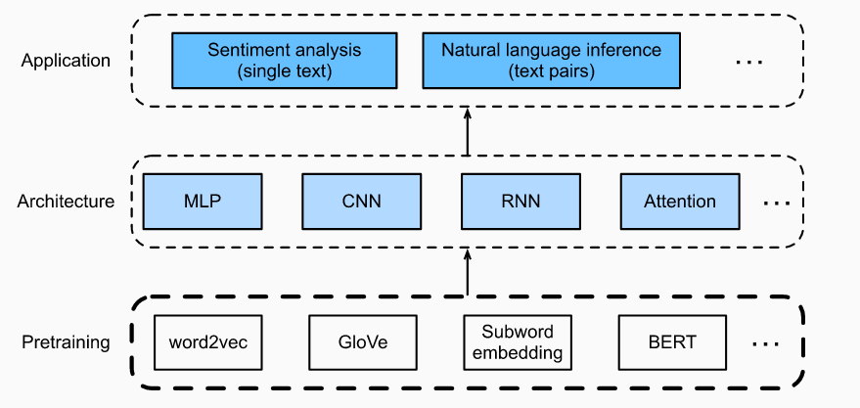
Natural Language Processing
Pretrained text representations can be fed to various deep learning architectures for different downstream natural language processing applications.
KNRTU-KAI | TU ILMENAU | Neural Networks

Slide 4
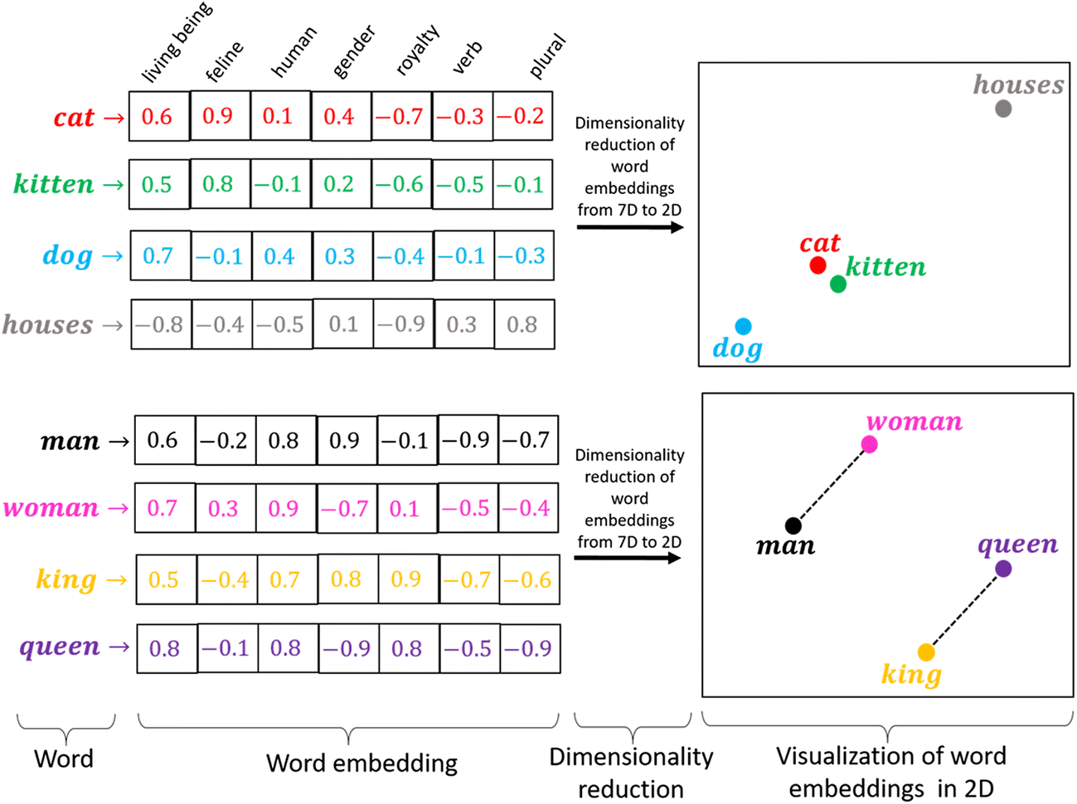
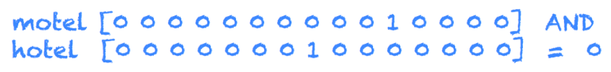
Word Embedding (word2vec)
The technique of mapping words to vectors of real numbers is also known as word embedding.

Slide 5
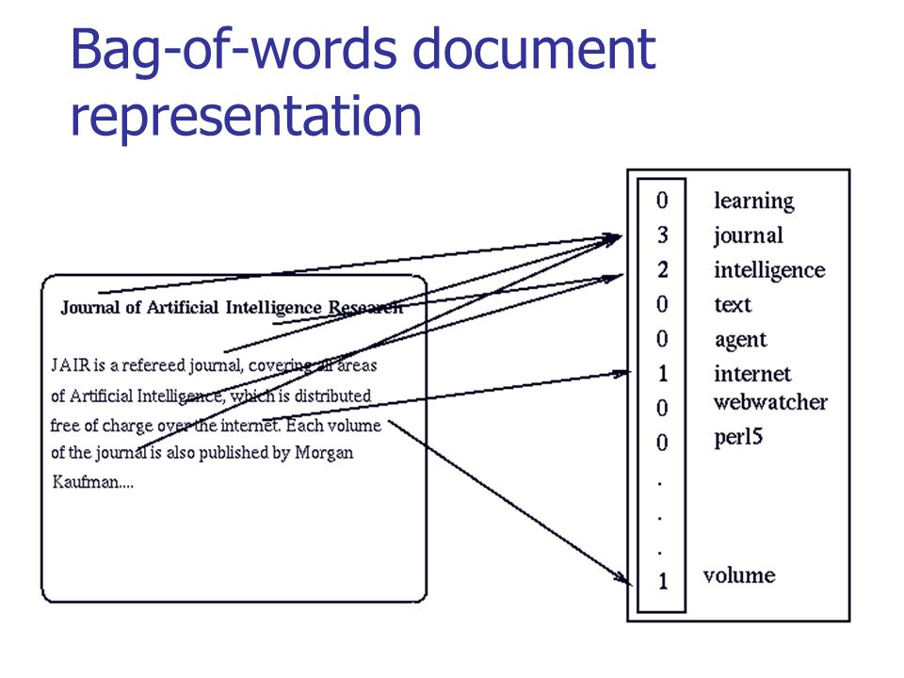
Word Embedding (word2vec)

Slide 6
Word Embedding (word2vec)
Although one-hot word vectors are easy to construct, they are usually not a good choice. One of the major reasons is that the one-hot word vectors cannot accurately express the similarity between different words, such as the cosine similarity that we commonly use.
Word2vec is a tool that we came up with to solve the problem above. It represents each word with a fixed-length vector and uses these vectors to better indicate the similarity and analogy relationships between different words.
The Word2vec tool contains two models: skip-gram and continuous bag of words (CBOW).
KNRTU-KAI | TU ILMENAU | Neural Networks

Slide 7

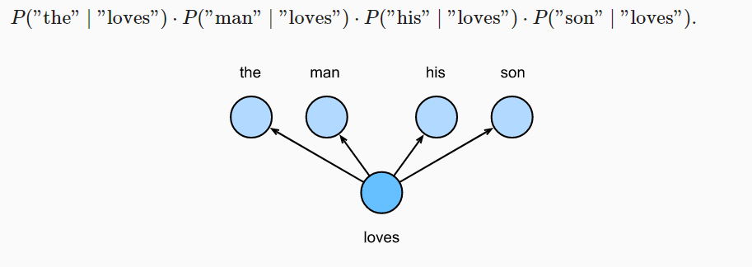
The Skip-Gram Model
The skip-gram model assumes that a word can be used to generate the words that surround it in a text sequence.
given the central target word “loves”, the skip-gram model is concerned with the conditional probability for generating the context words, “the”, “man”, “his” and “son”, that are within a distance of no more than 2 words
In the skip-gram model, each word is represented as two d -dimension vectors, which are used to compute the conditional probability.

Slide 8
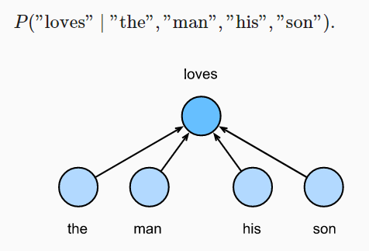
The Continuous Bag of Words (CBOW) Model
The biggest difference is that the CBOW model assumes that the central target word is generated based on the context words before and after it in the text sequence.
The CBOW model cares about the conditional probability of generating the central target word from given context words.
Since there are multiple context words in the CBOW model, we will average their word vectors and then use the same method as the skip-gram model to compute the conditional probability.
KNRTU-KAI | TU ILMENAU | Neural Networks

Slide 9
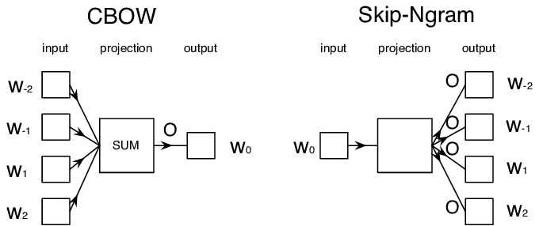
Word Embedding (word2vec)
KNRTU-KAI | TU ILMENAU | Neural Networks

Slide 10
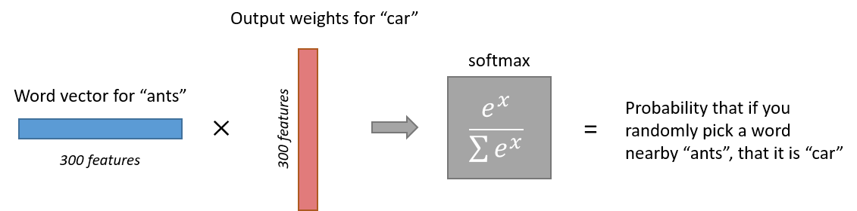
Word Embedding (word2vec)

Slide 11
Approximate Training
For both the skip-gram model and CBOW model, because they both get the conditional probability using a softmax operation, the gradient computation for each step contains the sum of the number of items in the dictionary size. For larger dictionaries with hundreds of thousands or even millions of words, the overhead for computing each gradient may be too high.
In order to reduce such computational complexity, two approximate training methods will be introduced: negative sampling and hierarchical softmax.

Slide 12
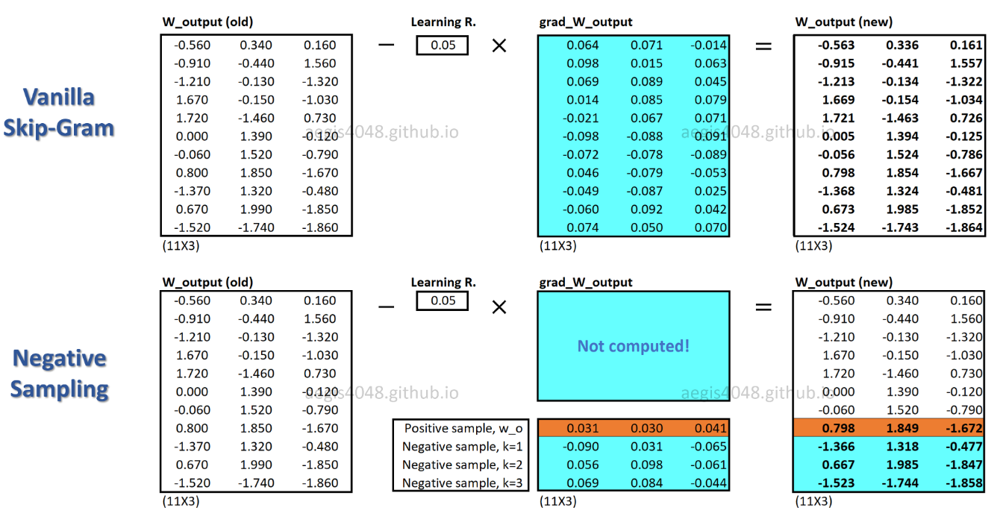
Negative Sampling
Negative sampling modifies the original objective function.
The essence of this approach is that we maximize the likelihood of meeting for the desired word in a typical context (the one that is often found in our corpus) and at the same time minimizing the likelihood of meeting in an atypical context (one that rarely or never occurs).

Slide 13
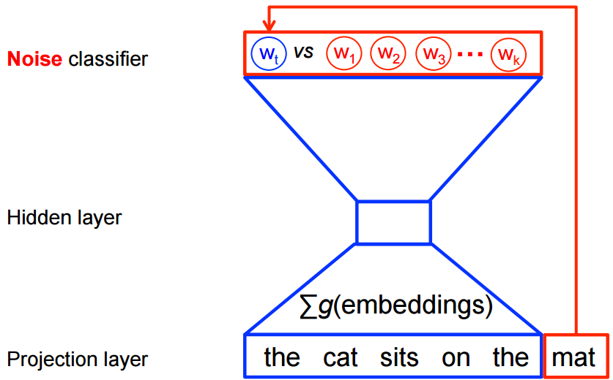
Negative Sampling
Negative sampling reduces computation by sampling just N negative instances along with the target word instead of sampling the whole vocabulary.
Technically, negative sampling ignores most of the ‘0’ in the one-hot label word vector, and only propagates and updates the weights for the target and a few negative classes which were randomly sampled.
More concretely, negative sampling samples negative instances(words) along with the target word and minimizes the log-likelihood of the sampled negative instances while maximizing the log-likelihood of the target word.
The negative samples are chosen using a unigram distribution.
Essentially, the probability for selecting a word as a negative sample is related to its frequency, with more frequent words being more likely to be selected as negative samples.

Slide 14
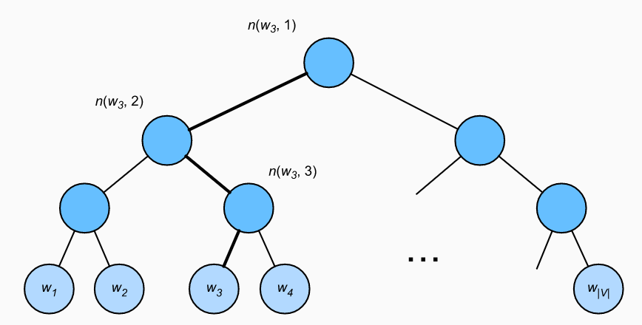
Hierarchical Softmax
Hierarchical softmax is another type of approximate training method. It uses a binary tree for data structure.
Each leaf node of the tree represents a word in the dictionary.
Hierarchical softmax uses a binary tree and constructs the loss function based on the path from the root node to the leaf node. The gradient computational overhead for each step in the training process is related to the logarithm of the dictionary size.

Slide 15
Word Embedding with Global Vectors (GloVe)
In some cases, the cross-entropy loss function may have a disadvantage. GloVe uses squared loss and the word vector to fit global statistics computed in advance based on the entire dataset.
The central target word vector and context word vector of any word are equivalent in GloVe.

Slide 16
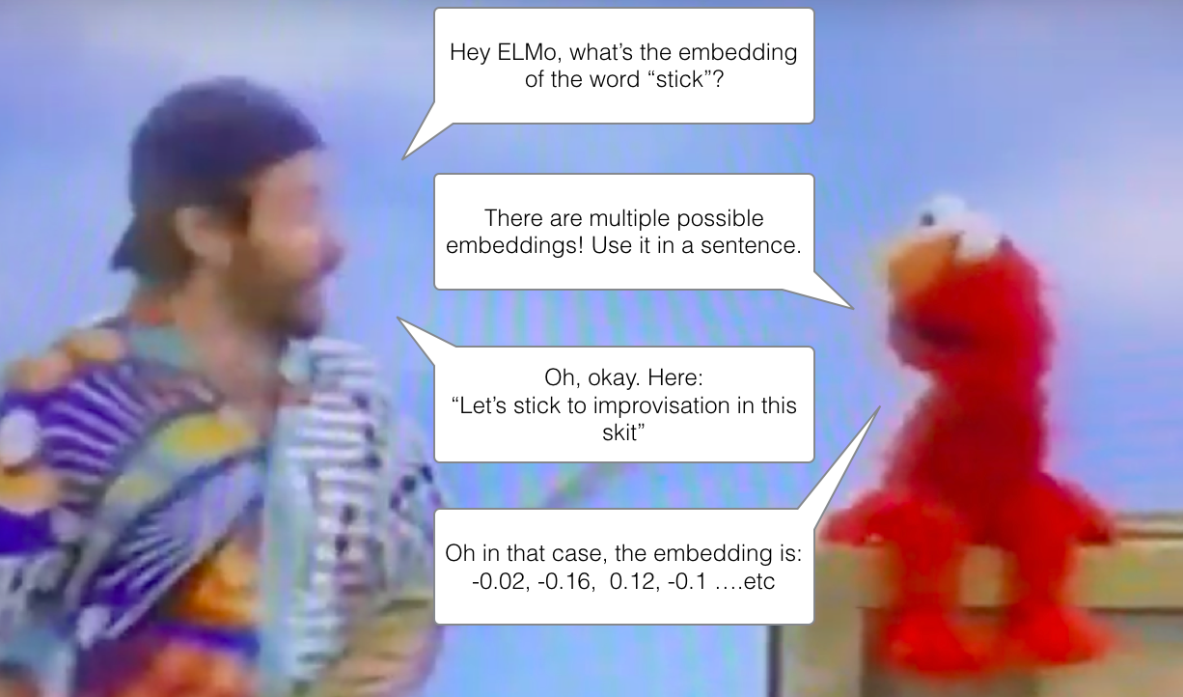
From Context-Independent to Context-Sensitive

Slide 17
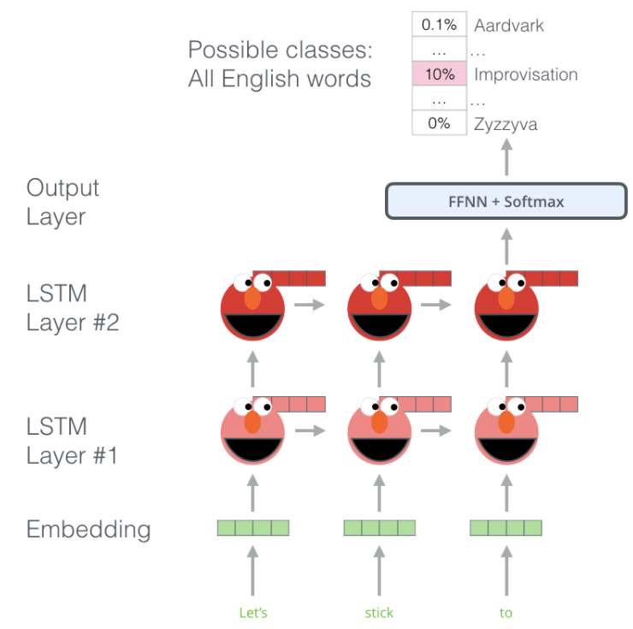
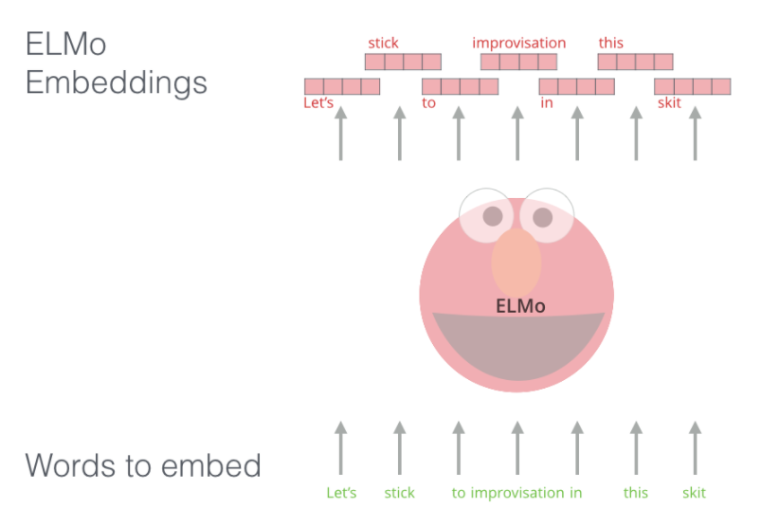
ELMo
ELMo gained the ability to understand language after learning to predict a new word in a sequence of words - a task called language modeling. This is convenient because we have large amounts of textual data that the model can learn from without having to mark it up.

Slide 18
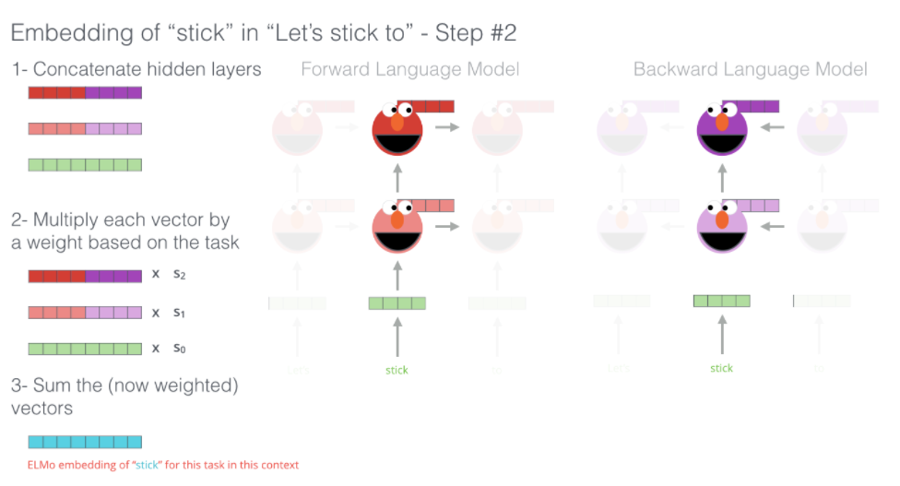
ELMo

Slide 19
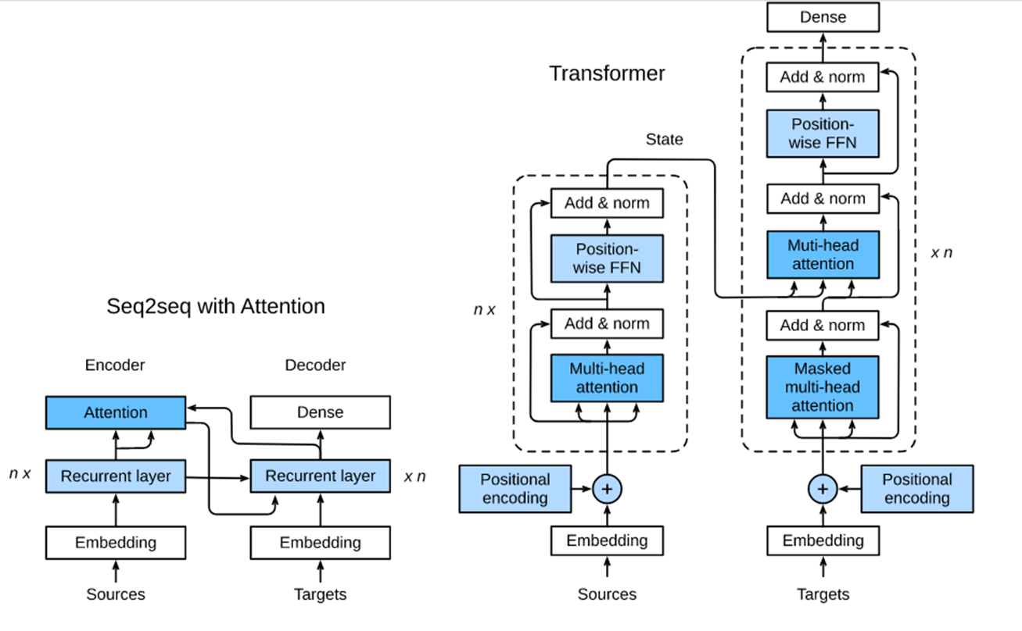
Bidirectional Encoder Representations from Transformers (BERT)

Slide 20

Bidirectional Encoder Representations from Transformers (BERT)

Slide 21
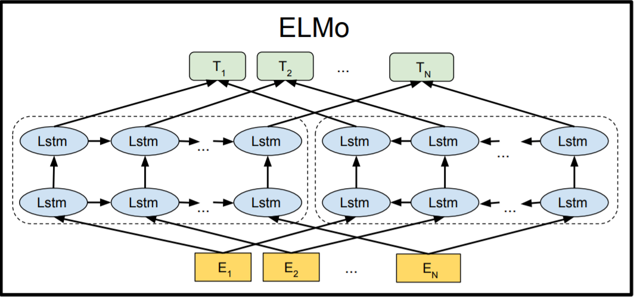
Bidirectional Encoder Representations from Transformers (BERT)
After word embedding models and pretraining, the output can be thought of as a matrix where each row is a vector that represents a word of a predefined vocabulary. In fact, these word embedding models are all context-independent.
In context-sensitive word representations representations of words depend on their contexts. Popular context-sensitive representations include TagLM (language-model-augmented sequence tagger), CoVe (Context Vectors), and ELMo (Embeddings from Language Models).
Leveraging different best models for different tasks at that time, adding ELMo improved the state of the art across six natural language processing tasks: sentiment analysis, natural language inference, semantic role labeling, coreference resolution, named entity recognition, and question answering.

Slide 22
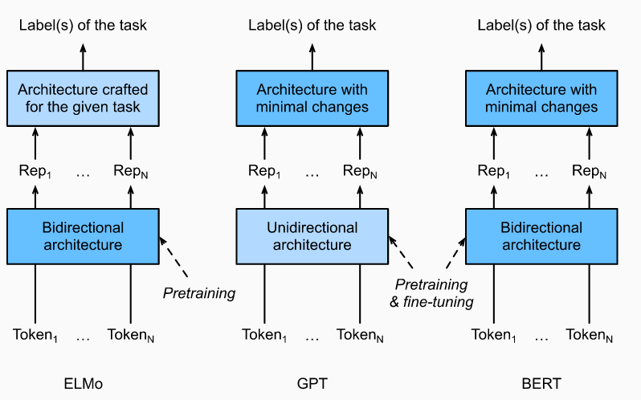
Bidirectional Encoder Representations from Transformers (BERT)
BERT (Bidirectional Encoder Representations from Transformers) encodes context bidirectionally and requires minimal architecture changes for a wide range of natural language processing tasks.
Using a pretrained Transformer encoder, BERT is able to represent any token based on its bidirectional context.
GPT (Generative Pre-Training)

Slide 23
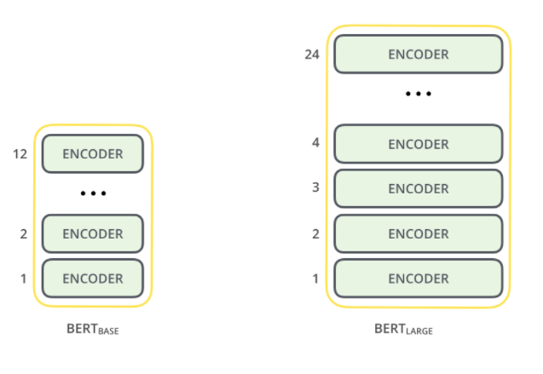
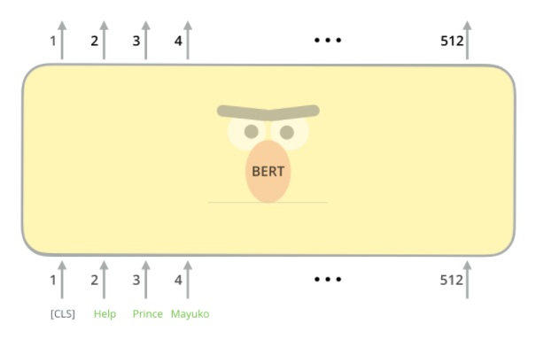
Bidirectional Encoder Representations from Transformers (BERT)

Slide 24
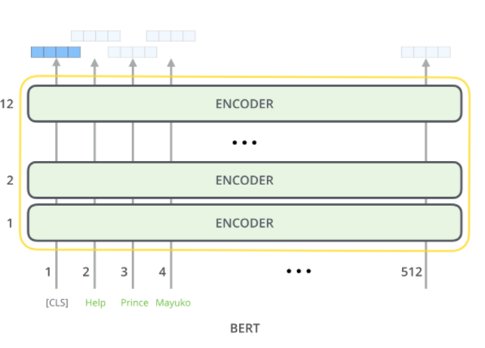
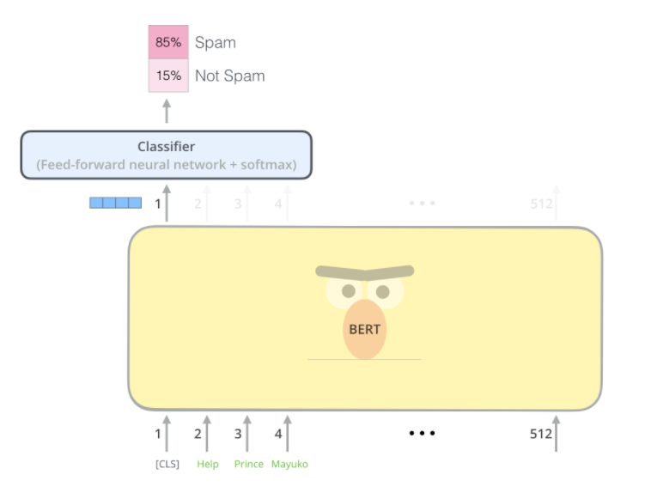
Bidirectional Encoder Representations from Transformers (BERT)

Slide 25
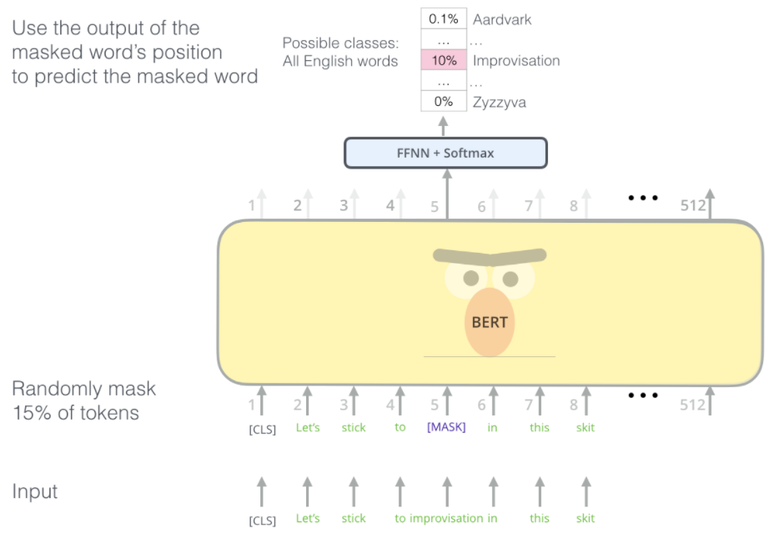
Bidirectional Encoder Representations from Transformers (BERT)

Slide 26
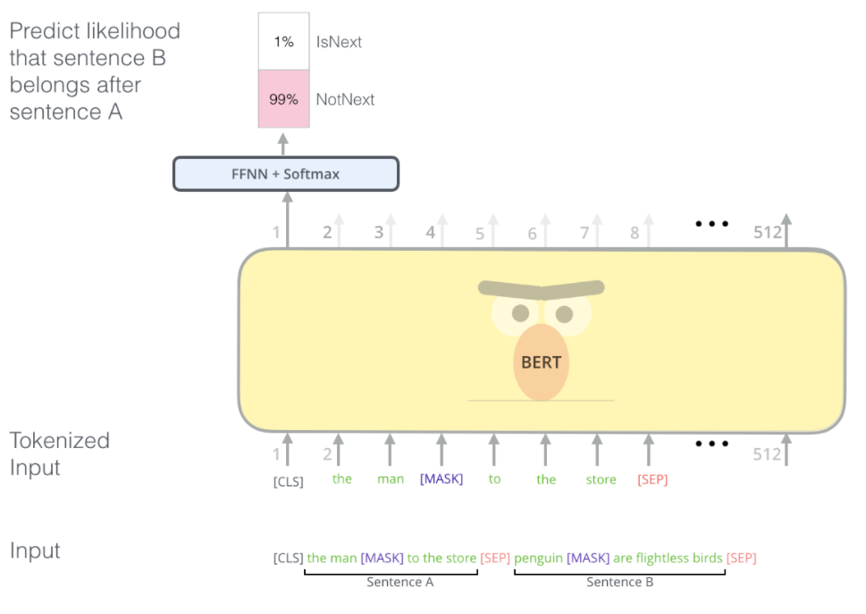
Bidirectional Encoder Representations from Transformers (BERT)
https://jalammar.github.io/illustrated-bert/

